Slide 1
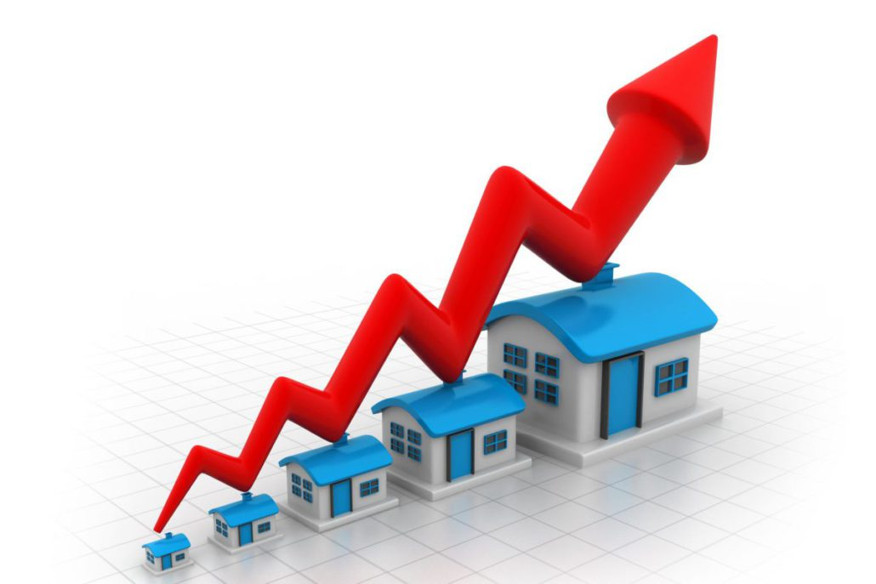
HOUSING: PRICE PREDICTION
Submitted By:
Lakshmi Rajendra Thute

Slide 2
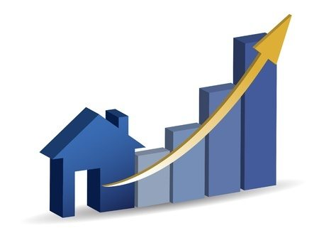
INTRODUCTION
Houses are one of the necessary need of each and every person around the globe and therefore housing and real estate market is one of the markets which is one of the major contributors in the world’s economy. The main objective of this project is to build a model to predict the price of the houses based on the features mentioned in the dataset

Slide 3
ANALYTICAL PROBLEM FRAMING
A US-based housing company named Surprise Housing has decided to enter the Australian market. The company uses data analytics to purchase houses at a price below their actual values and flip them on at a higher price. For the same purpose, the company has collected a data set from the sale of houses in Australia.
The company is looking at prospective properties to buy to enter the market. You are required to build a regression model using regularisation in order to predict the actual value of the prospective properties and decide whether to invest in them or not.
The company wants to know:
Which variables are significant in predicting the price of a house, and
How well those variables describe the price of a house

Slide 4
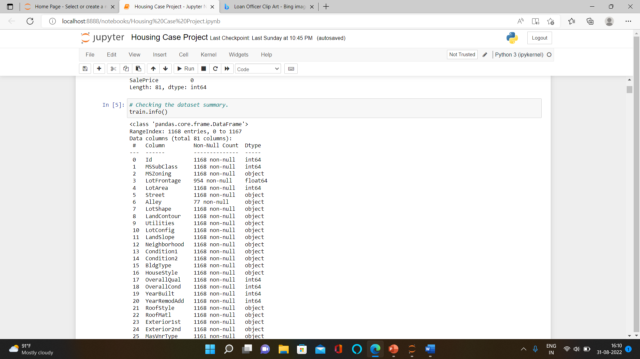
DATA COLLECTION AND PRE-PROCESSING
Data-Collection: I got the dataset in CSV format and I read the data in Jupyter Notebook using pandas data frame.
Shape of data: The dataset contains total 1168 rows and 81 columns.
Data Summary: The dataset contains 3 float, 36 integer and 43 object data type columns
Missing Values: The dataset contains missing values and we treat them with mean and mode imputation.
Mean Imputation for numerical columns and mode imputation for categorical columns.

Slide 5
EXPLORATORY DATA ANALYSIS

Slide 9
Observations:
1.lotFrontage: Almost all houses have Lot Frontage between 20 to 150
2.lotArea: Around 580 house have lot Area between (0-10000)sqft. Very few houses have lot area aound 120000sqft & around 160000sqft
3.OverallQual: Rates the overall material and finish of the house, Around 300 houses sold were in average condition. Only 10-15 houses were in excellent condition.
4.YearBuilt: Original construction date, More number of people have brought the houses build after 1990.
5.MasVnrArea: Masonry veneer area in square feet, 50% of houses have Masonry veneer area as '0-50' and out of rest 50% houses most houses have Masonry veneer area 50-1200
6.BsmtFinSF1: Type 1 finished square feet, Most houses have Type 1 finished square feet area of basement between 0 and 1500
7.BsmtFinSF2: Type 2 finished square feet, Around 1000 houses have Type 2 finished square feet area of 0
8.BsmtUnfSF: Unfinished square feet of basement area, Around 130 houses have unfinished basement of area around 100-500 sqft.
9.1stFlrSF: First Floor square feet, Around 280 houses have 1st floor square feet area between 800-1200sqft.
10.GrLivArea: Above grade (ground) living area square feet, Most houses have above ground living sq ft area in between 800 to 3000

Slide 10
11.BsmtFullBath: Basement full bathrooms,50% houses have no full bathrooms in basement and in remaining houses most have 1 full bathroom in basement and very few has 2 full bathrooms.
12.FullBath: Full bathrooms above grade,25% houses have 1 full bathrooms above ground and 50% have 2 full bathrooms located above ground and very less have 3.
13.HalfBath: Half baths above grade, around 700 houses have no half bathrooms very few has 1 half bathroom.
14.Bedroom: Bedrooms above grade (does NOT include basement bedrooms), Most houses have 3 bedrooms above ground followed by 2 and 4.
15.Kitchen: Kitchens above grade, Maximum houses have 1 Kitchen. very few have 2.
16.TotRmsAbvGrd: Total rooms above grade (does not include bathrooms), Around 300 houses have 6 rooms, around 200 have 5, &250 have 7. Very few have 12 & 14 rooms.
17.Fireplaces: Number of fireplaces, Most houses have 0 fireplaces followed by 1.
18.GarageCars : Size of garage in car capacity, Most houses have garage with 2 car capcity.
19.GarageArea : Size of garage in square feet, Most houses have Garage area in between 200 to 800.
20.woodDeckSF : Wood deck area in square feet, More than 50% of houses have 0 Wood Deck sqft area and rest have in between 0 to 400
21.OpenPorchSF : Open porch area in square feet, 25% of houses have 0 open porch sqft area and rest have in between 0 to 300
22.EnclosedPorch : Enclosed porch area in square feet, Almost all houses have 0 enclosed porch sqft area
23.ScreenPorch : Screen porch area in square feet, Almost all houses have 0 screen porch area sqft
24.Sale Price : Around 500 houses have sale price in between 100000 to 200000. Very few houses have sale price of 600000 & 70000

Slide 11
Bivariate Analysis

Slide 20
FEATURE ENCODING

Slide 21
MODEL BUILDING AND EVALUATION

Slide 22
Here we design the above algorithms for the dataset and Gradient Boosting Regressor performs very well for the dataset.

Slide 23
HYPER PARAMETER TUNNING FOR GRADIENT BOOSTING REGRESSOR

Slide 25
Here after hyper parameter tunning we can see most of the datapoints are close to best fit line and we got the final r2 score as 90% which very good

Slide 26
THANK YOU

